Slide 1
Online learning website
By
Arfiya Shaikh
Shaheen Angadgiri
Alamgir Mulla
Yaseen Lone
Rushikesh Polekar

Slide 2
introduction
Online learning allows us to bring educational opportunities to you. This type of learning is especially beneficial to students who live far away from campus, have busy work schedules, family demands, and other commitments. Online courses are also an excellent option for students who prefer to work independently at any time of day.
Our website is a free study portal where you can study programming languages. This website, is an independent online platform created for educational and informational purposes. We want to make it clear that Our website is not affiliated with any corporation.

Slide 3
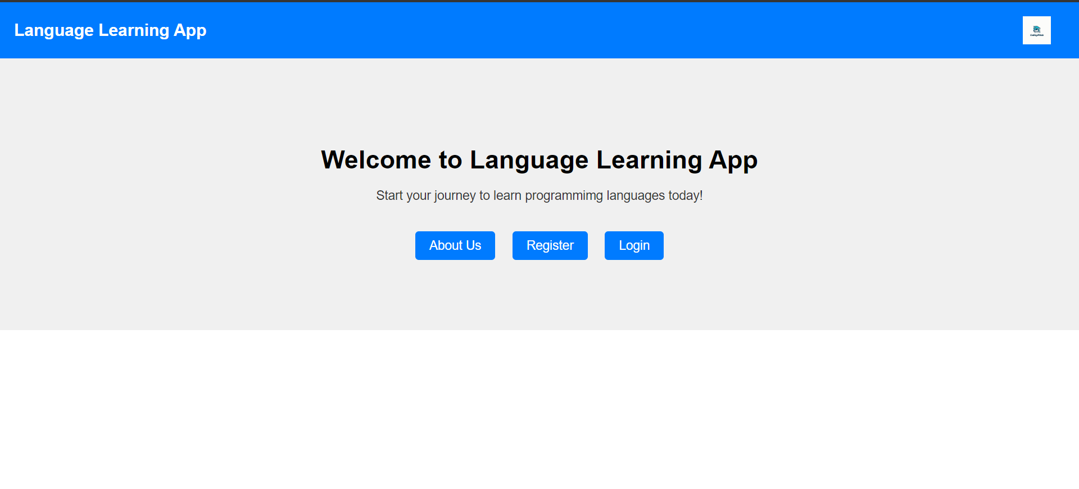
Home page

Slide 4
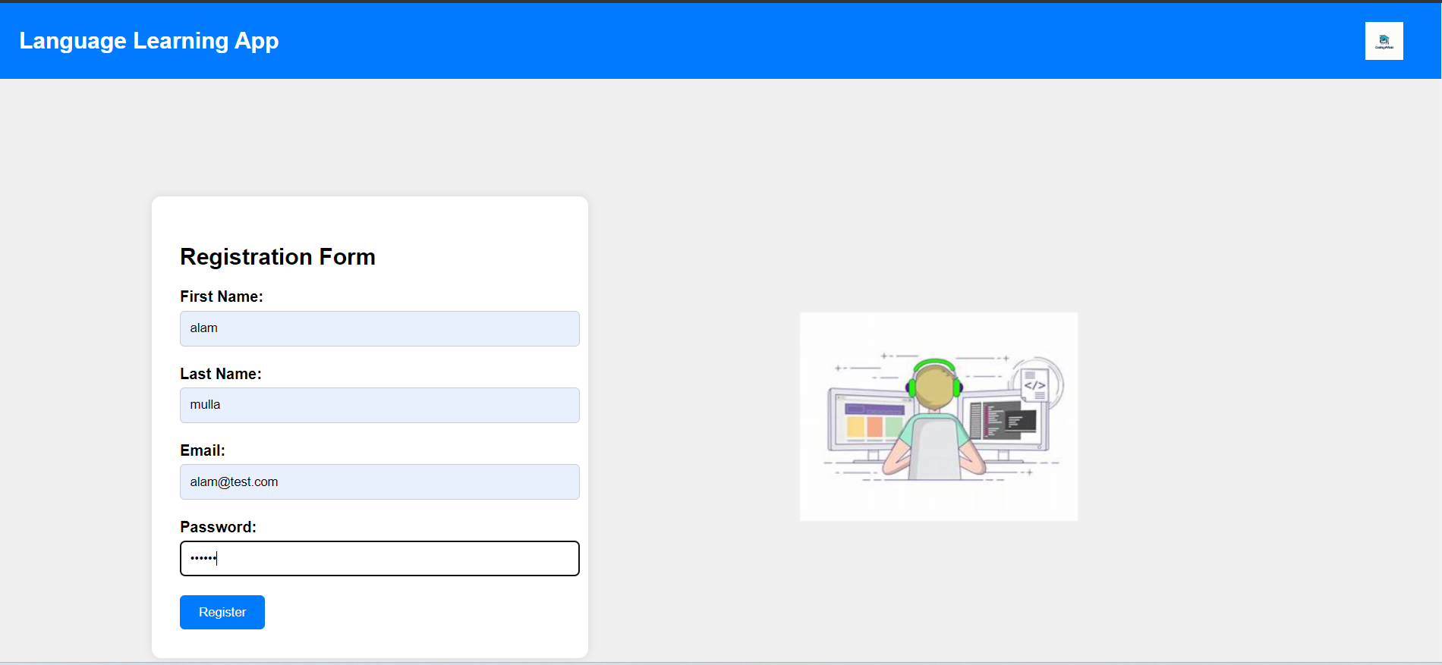
Registration page

Slide 5
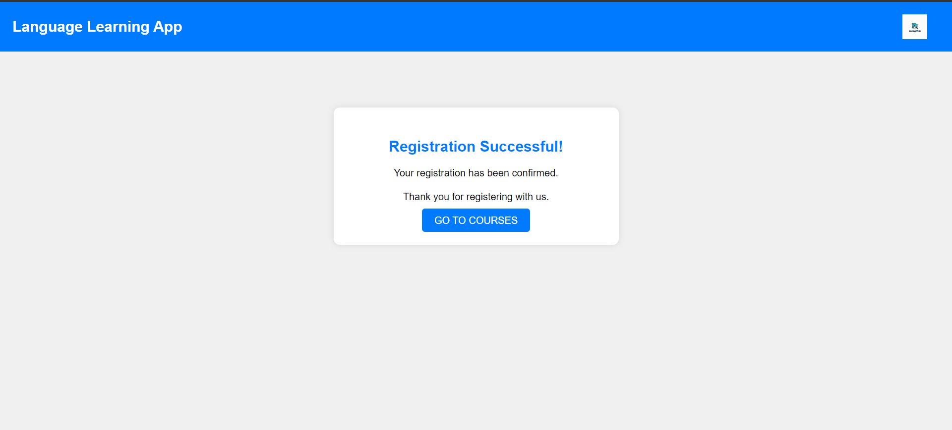
Registration successful page

Slide 6
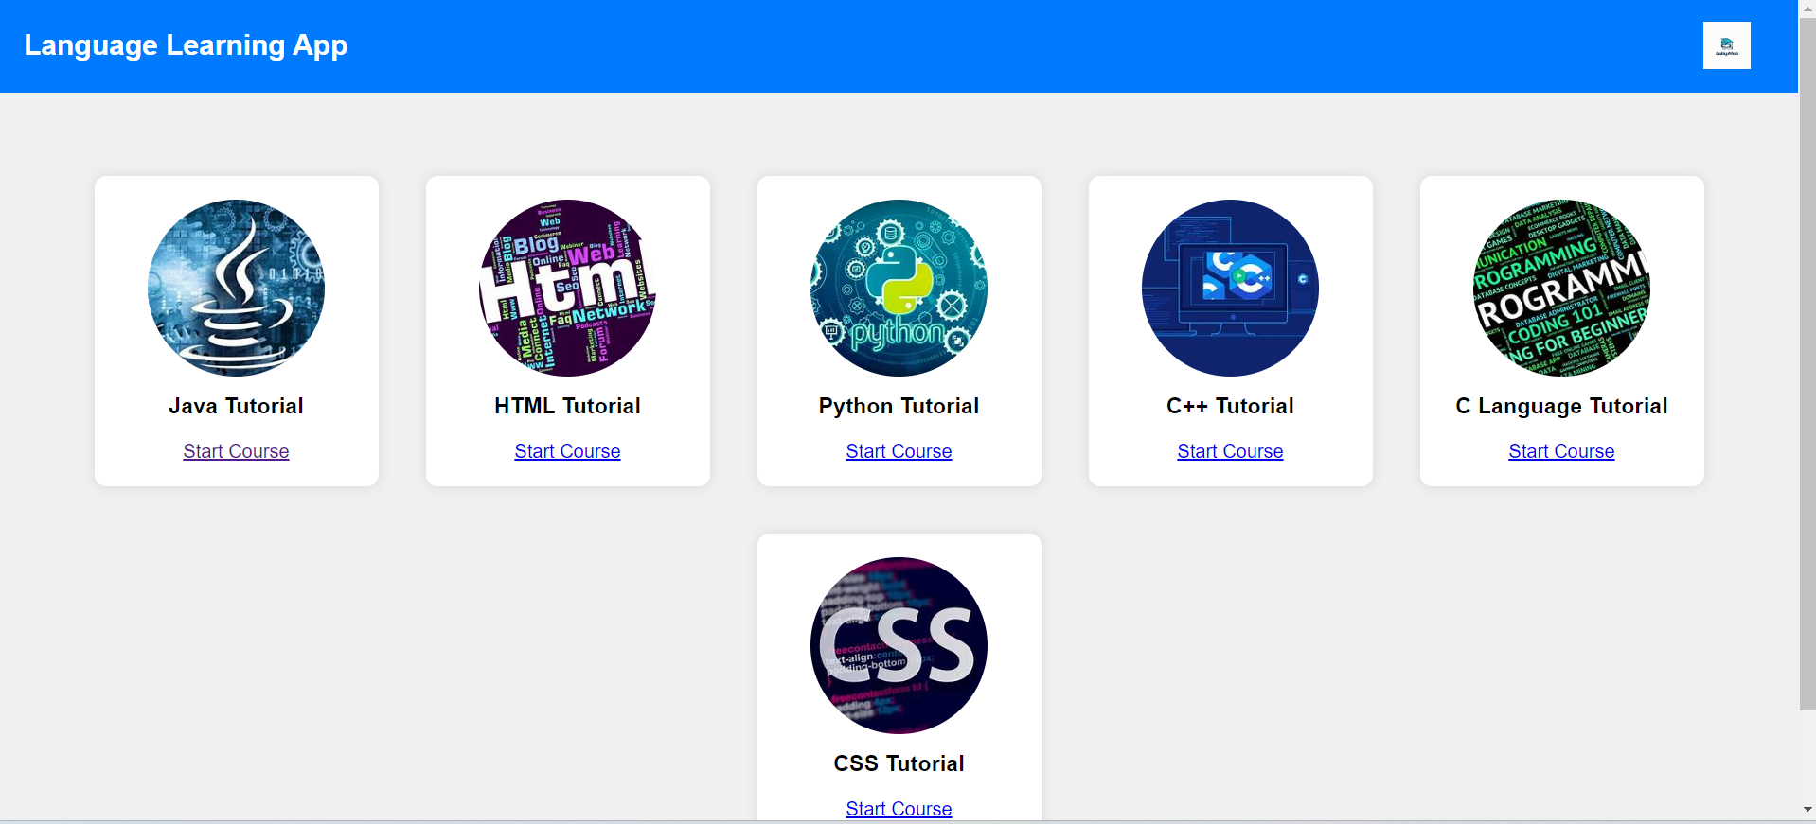
Course page

Slide 7
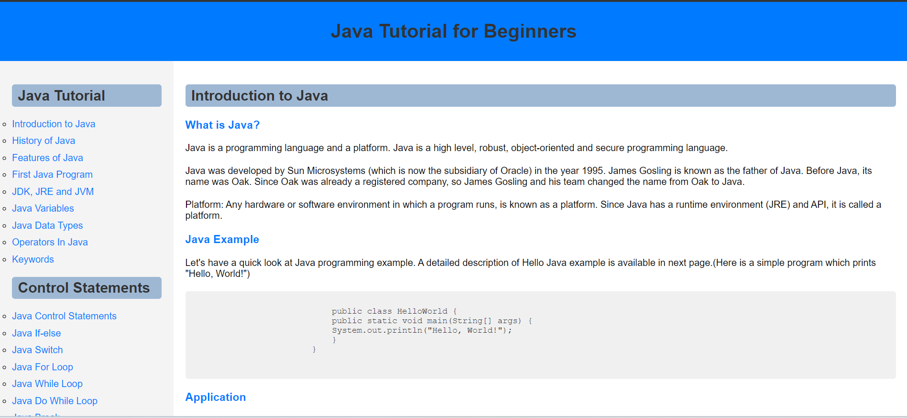
Example of tutorial pages

Slide 8
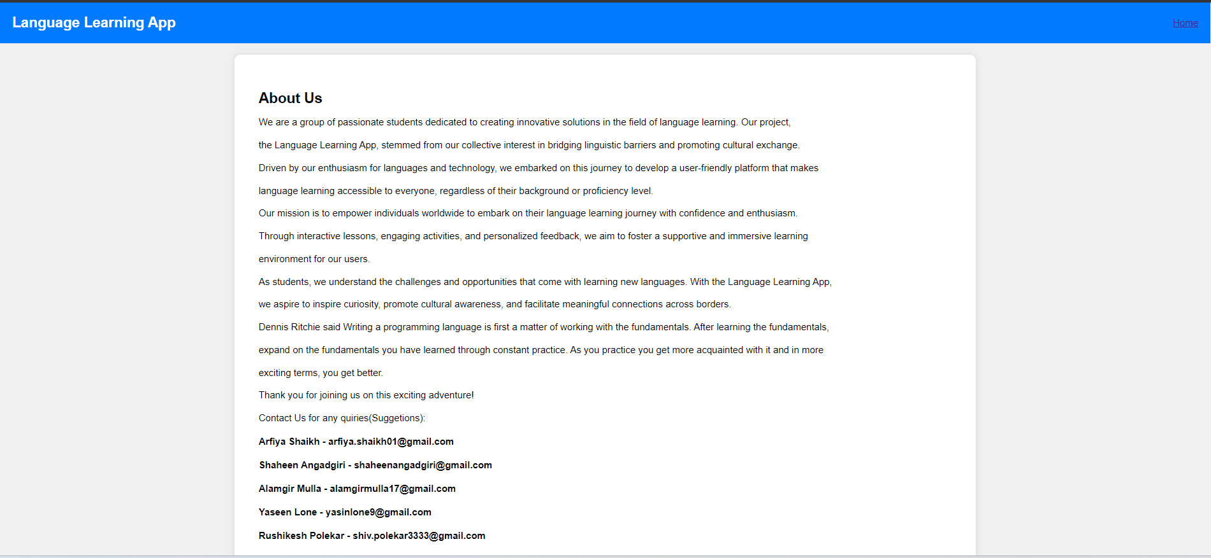
About Us page

Slide 9
THANK you

